Slide 1



Home
About
Content
End
Page 01
Decoding the Washington Cannabis Market:
From Raw Data to Strategic
Insights
A focused analysis of Washington State’s cannabis market, one of the world’s most mature and tightly regulated industries.

Slide 2


Home
About
Content
End
Page 02
Our Goal:
Turning complex, high-volume market data into clear, actionable insights for stakeholders, supply-chain teams, and investors.
Analytical Pillars:
    Product Quality & Compliance
    Financial Efficiency & Inventory Risk
    Sales Dynamics & Market Trends

Slide 3

Home
About
Content
End
Page 03
Quality & Standards Analysis:
Understanding market potency trends (THC vs. CBD) and laboratory testing priorities.
Financial Risk Management (FRM):
Evaluating inventory valuation and identifying capital risks associated with perishable goods.
Market Dynamics & Trends:
Tracking the evolution of sales, identifying dominant strains, and analyzing consumer behavior shifts.

Slide 4

Home
About
Content
End
Page 04
The Big Data Challenge
Volume: Successfully processed and analyzed over Millions Records across the dataset.
Format: The raw data was stored in Parquet format (Columnar Storage), requiring specialized data engineering techniques for extraction.
Complexity: Handled a relational schema of
8 interconnected tables covering the entire "Seed-to-Sale" lifecycle.

Slide 5

Home
About
Content
End
Page 05
Processing Hurdles & Engineering Solutions
Challenge 1: File Compatibility
Issue: Parquet files are incompatible with traditional spreadsheet tools.
Solution: Utilized Python libraries (pyarrow, fastparquet) for efficient data ingestion.

Slide 6
Home
About
Content
End
Page 06
Processing Hurdles & Engineering Solutions
Challenge 2: Connectivity Challenge (Bridging Python & SQL)
Issue: The Communication Gap [Python & SQL Server] are separate environments that cannot communicate directly by default.
Solution: Implemented the ODBC Driver to act as a secure "translator" and bridge. This enabled seamless, high-speed data transfer from the coding environment to the database without manual errors.

Slide 7
Home
About
Content
End
Page 07
Processing Hurdles & Engineering Solutions
Challenge 3: Infrastructure Limits
Issue: The raw uncompressed data exceeded the 10GB storage limit of SQL Server Express.
Solution: We solved this by splitting the analytics into 5 different categories. Each category only needed a specific set of tables, not the whole database.

Slide 8
Home
About
Content
End
Page 08
Processing Hurdles & Engineering Solutions
Challenge 4: Data Quality (Noise)
Issue: The dataset contained significant noise, including impossible dates (e.g., 1970), negative values, and logical duplications.
Solution: Implemented rigorous data cleaning and validation scripts to ensure analytical accuracy.

Slide 9


Home
About
Content
End
Page 09
Methodology & Tech Stack
1. Data Ingestion & Preparation Layer
Tools: Python (Pandas, PyArrow), VS Code.
Role: Handling heavy lifting and raw Parquet files.
Key Tasks: Data Cleaning & Validation (removing outliers, fixing dates).
ODBC Integration for secure data transfer.

Slide 10
Home
About
Content
End
Page 10
Methodology & Tech Stack
2. Data Warehousing & Analysis Layer (The Brain):
Tools: Microsoft SQL Server (SSMS).
Role: Centralized storage and relational logic.
Key Tasks: Executing complex queries (Joins, Grouping) to answer business questions.

Slide 11
Home
About
Content
End
Page 11
Methodology & Tech Stack
3. Visualization & Storytelling Layer (The Face):
Tools: Power BI.
Role: Transforming numbers into interactive narratives.
Key Tasks: Building dashboards for stakeholders.
Visualizing trends (Sales Evolution) and risks (Inventory Valuation).

Slide 12
Home
About
Content
End
Page 12
Data Quality Assurance Framework
1. Structural Integrity (السلامة الهيكلية):
Eliminated Redundancy: Removed over 96,000 fully duplicate records to ensure statistical accuracy.
Optimized Schema: Dropped completely empty columns (e.g., InventoryIdentifier) to reduce noise.

Slide 13
Home
About
Content
End
Page 13
Data Quality Assurance Framework
2. Standardization & Normalization (التوحيد):
Unified text formats (Lowercase) to merge categories (e.g., 'Waste' vs 'waste').
Corrected data entry typos (e.g., fixed 'etract' to 'extract') to consolidate product lines.

Slide 14
Home
About
Content
End
Page 14
Data Quality Assurance Framework
3. Business Logic Validation (التحقق المنطقي):
Enforced "Impossible Values" rules:
Removed records with negative weights, quantities, or costs (0.5% of data).
Sanitized Temporal Data:
Converted default system dates (e.g., 1970-01-01) to nulls to prevent analysis skew.

Slide 15
Home
About
Content
End
Page 15
Data Quality Assurance Framework
4. Primary Key Verification (التحقق من المفاتيح):
Validated Primary Keys:
to ensure uniqueness before relational joining.

Slide 16

Home
About
Content
End
Page 16
Solving
Critical Data Anomalies

Slide 17

Home
About
Content
End
Page 17
The "Logical Duplicate" Trap:
Issue: InventoryId appeared duplicated due to a business rule (logged twice as Medical/Recreational).
Solution: Applied Logical Deduplication to retain a single unique record per item, preventing double-counting of assets.

Slide 18
Home
About
Content
End
Page 18
Extreme Outliers (The "Fat Finger" Error)
Issue: Identified catastrophic data entry errors (e.g., 100 Million units with $0 cost, or 227kg items)
Solution: Calculated Statistical Percentiles (99.9%) to establish logical upper limits and filtered out 0.01% of data that was skewing averages

Slide 19
Home
About
Content
End
Page 19
The "Zero-Cost" Paradox:
Issue: Found 2.1 Million items with quantity but zero cost.
Solution: Retained these records after investigation revealed they represent operational items (Samples, Plants, Waste), flagging them for specific analysis rather than deletion.

Slide 20
Home
About
Content
End
Page 20
The Strategic Story (3 Pillars)
1: Market Identity (Efficiency & Risk)
2: Financial Health (The Liquidity Trap)
3: Sales Evolution (The Shift)

Slide 21
Home
About
Content
End
Page 21
Strategic Analysis Framework
1. Sales & Revenue Dynamics:
Focus: Analyzing growth trends since 2014 and identifying the most profitable sales channels

Slide 22
Home
About
Content
End
Page 22
Strategic Analysis Framework
2. Product Quality & Standards:
Focus: Deciphering consumer demand (Potency vs. Therapy) and strain dominance.

Slide 23
Home
About
Content
End
Page 23
Strategic Analysis Framework
3. Inventory Health & Cost:
Focus: Evaluating asset value and shelf-life risks.

Slide 24
Home
About
Content
End
Page 24
Strategic Analysis Framework
4. Market Structure (Licensees):
Focus: Mapping market players and testing infrastructure.

Slide 25
Home
About
Content
End
Page 25
Strategic Analysis Framework
5. Geography & Supply Chain:
Focus: Tracing the flow from farm to retail hubs.

Slide 26
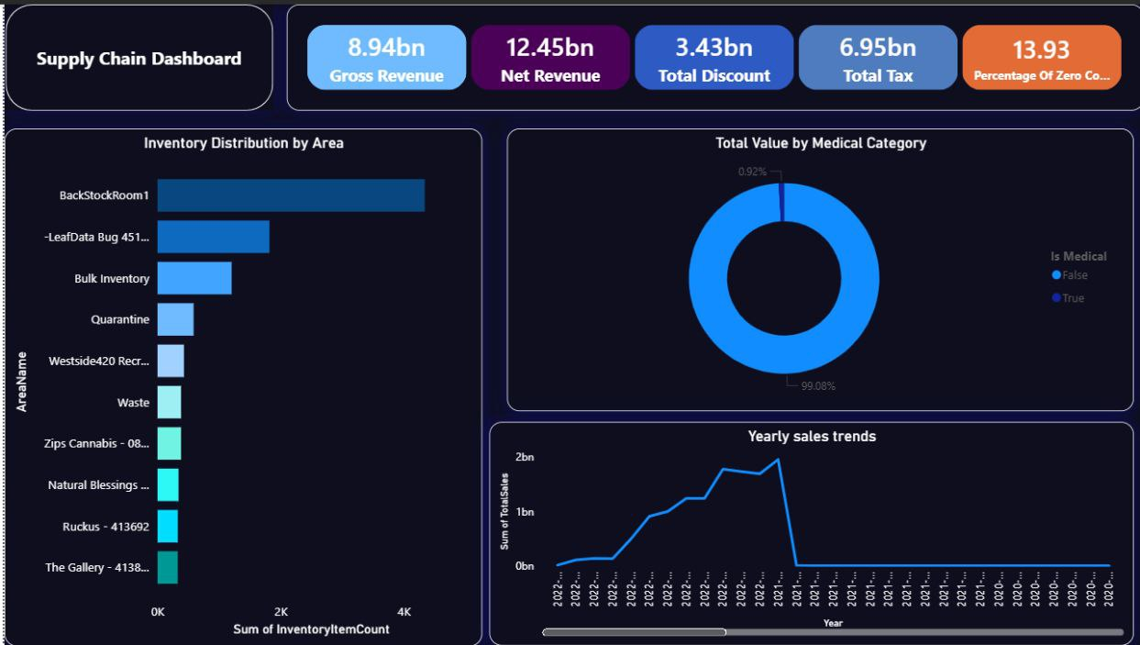
Home
About
Content
Others
Page 26
Dashboard

Slide 27
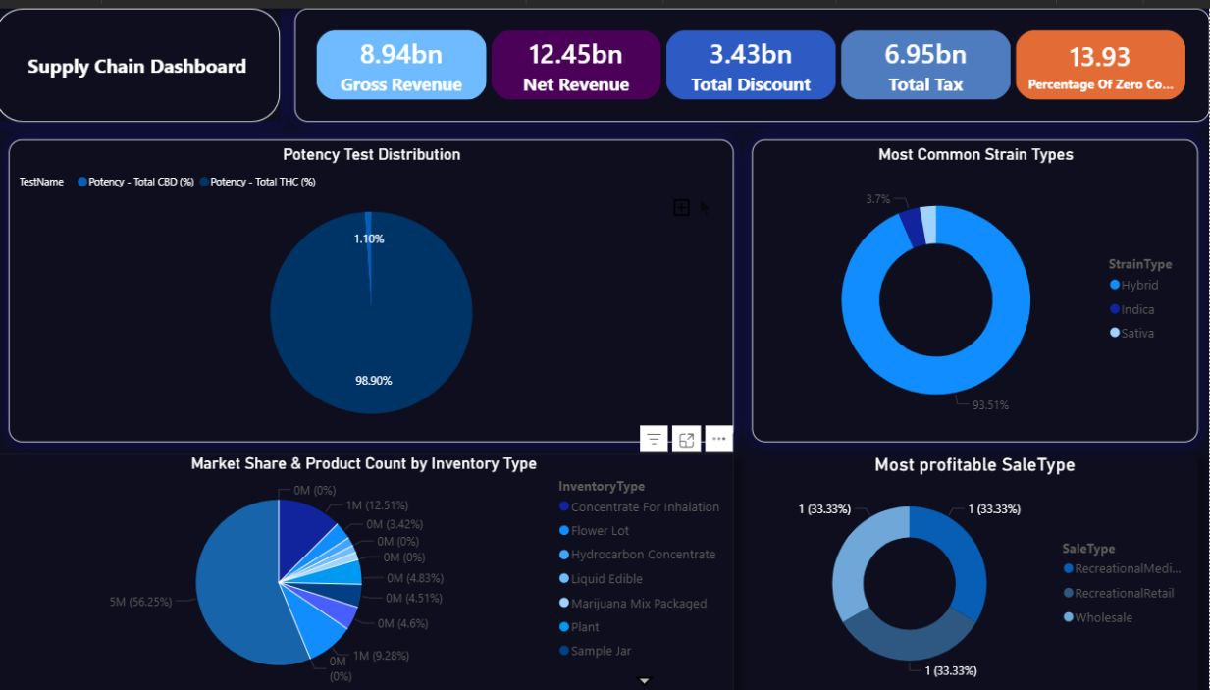
Home
About
Content
Others
Page 27
Dashboard

Slide 28
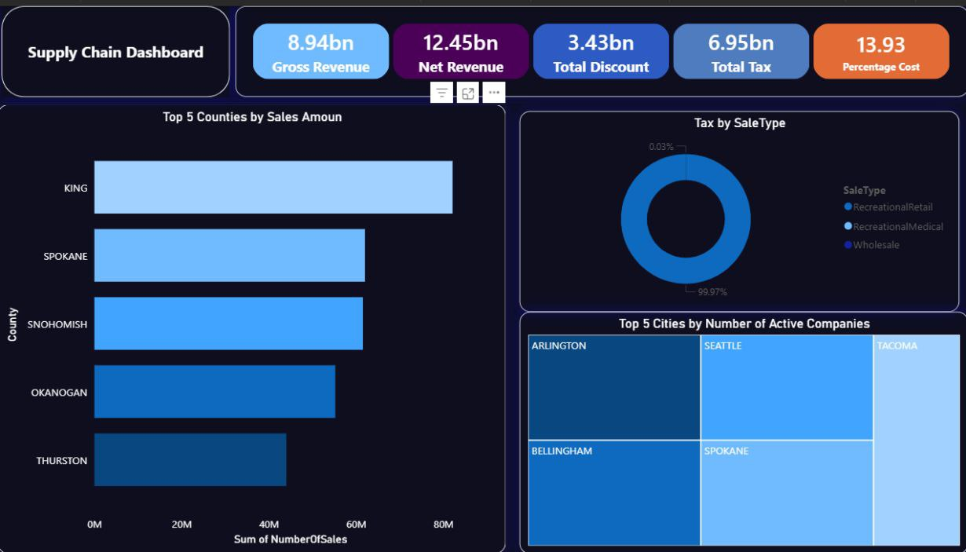
Home
About
Content
Others
Page 28
Dashboard

Slide 29
Home
About
Content
Others
Page 30
Recommendations

Slide 30

Home
About
Content
End
Page 30
1. Portfolio Strategy (The 80/20 Rule):
Action: Allocate 80% to High-THC Hybrids (Volume) and 20% to Pure Strains (Premium Margin).

Slide 31
Home
About
Content
End
Page 31
2. Financial Risk Mitigation (JIT Model):
Action: Implement Just-In-Time (JIT) inventory for "Flower" to mitigate the $10B liquidity risk due to spoilage.

Slide 32
Home
About
Content
End
Page 32
3. Operational Efficiency
(Waste Optimization):
Action: Repurpose the 14% Zero-Cost inventory (Waste) into Extraction lines to generate revenue from operational byproducts

Slide 33
Home
About
Content
End
Page 33
4. Marketing Shift
(Effect-Based Branding):
Action: Replace complex naming with "Effect Categories" (e.g., Relax, Focus) to align with mass-market consumer behavior.

Slide 34
Home
About
Content
End
Page 34
5. Geo-Logistics (Hub-and-Spoke Model):
Insight: Demand is highly concentrated in King & Spokane counties.
Action: Centralize distribution hubs near these urban centers to minimize last-mile delivery costs.

Slide 35
Home
About
Content
End
Page 35
6. Pricing & Taxation
(Volume-Driven Model):
Insight: 99.9% of tax revenue comes from Recreational Retail.
Action: Adopt a High-Volume/Competitive Pricing strategy in the recreational sector to offset the heavy tax burden.

Slide 36
Home
About
Content
Others
Page 36
Chat bot

Slide 37



Home
About
Content
End
Page 37
Thank You
Prepared By:
1- Mohmed Salah
2- Mostafa Ashraf Said
3- Mostafa mohamed
4- Omar Ashraf Abushosha
5- Mahmoud Ayman Ahmed

